Slide 1
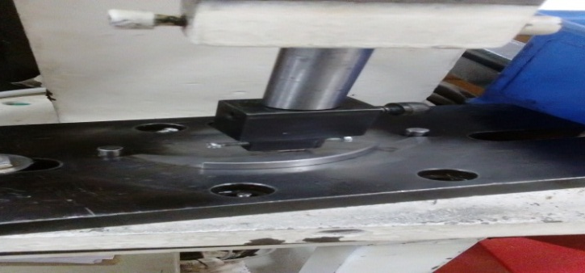
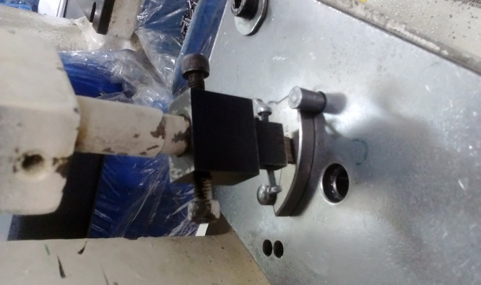
P15
TPM CIRCLE NO :- 01
ACTIVITY
KK
QM
PM
JH
SHE
OT
DM
E&T
KAIZEN IDEA SHEET
TPM CIRCLE NAME: Oil Pump
LOSS NO. / STEP
DEPT :- QA
RESULT AREA
P
Q
A
C
D
S
M
B
CELL :- A315
CELL NAME:- De-comp
MACHINE / STAGE :- Number punching
OPERATION :-Date punching
KAIZEN THEME : To avoid customer complaint decomp line
IDEA :-Fixture design needs to change
COUNTERMEASURE:-
1) To get rigid resting fixture procured with guide pins
BENCHMARK
1949 Nos
Problem present status :- operator fatigue due to move able flyweight on number punching fixture
TARGET
0 Nos
KAIZEN START
25.9.2016
KAIZEN FINISH
20.10.2016
TEAM MEMBERS : Sushma thorat, Nitin Sutar
Mohan Kate, Bhavesh Pednekar.,Samadhan bankar
BENEFITS :-
No customer complaint
Time saving
Date punching operation easier
No pins available for flyweight resting
Before
After
KAIZEN SUSTENANCE
WHY - WHY ANALYSIS :-
Why1 : operator fatigue in resting flyweight
Why2:-flyweight is movable
Why3 :- No guide pins locate in fixture
Why4 :- Free play of flyweight on number
Why 5: Weak design
RESULT :-
WHAT TO DO: Point should be added in fixture validation sheet
HOW TO DO: By audit
FREQUENCY –
SCOPE & PLAN FOR HORIZONTAL DEPLOYMENT
Sr No | CELL | TDC | RESP. | STATUS
1 | All Casting |  | Mr. Nitin sutar | Completed
ROOT CAUSE : Weak fixture design
REGISTRATION NO. & DATE : 18.11.2016
REGISTERED BY :- Sushma thorat
MANAGER’S SIGN :- Sandeep patil

